Slide 1

IMPACT OF POPULATION AGING ON CANCER INCIDENCE AND MORTALITY IN SOUTH KOREA : PROEJCTION MODEL-BASED STUDY
Final Defense of Master Thesis
MPH Candidate Hoejun Kwon
Department of Cancer Control and Population Health
Supervisor
Hyunsoon Cho
Department of Cancer AI & Digital Health
Academic Year 2023-2024
Notes:
Hello profressor and committe member
good afternoon today
My name is Hoejun Kwon, Thank you for joining us for today's final defense for master thesis
I've made some changes to this presentation in response to previous comments.
My thesis topic is “IMPACT OF POPULATION AGING ON CANCER INCIDENCE AND MORTALITY IN SOUTH KOREA : PROEJCTION MODEL-BASED STUDY”
I'll explain the table of contents on the next page

Slide 2

OUTLINE
OUTLINE
► INTRODUCTION
- Why focus on aging in cancer burden measurement?
- How to ageing in cancer burden?
- Previous study limitation? & Objective
► METHODS
- Introduction using data
- Introduction selection ageing related cancer framework
- Introduction Projection Models & Decomposition analysis
► ANALYSIS & RESULTS
-Result I : Validation Check for ageing related cancer
-Result II: Comparison differences in results by model
-Result III : Comparison projections from different scenario
► DISCUSSION
► CONCLUSION & CONTRIBUTION
[ referecnced by IACR ]
Notes:
The table of contents is organized as follows
In the introduction, i briefly describe the background and goals of the study.
I will then present the methodology and data used in the study and the framework within which the study was conducted, followed by the results of the analysis.
Finally, i will discuss the significance findings, limitations, and conclusions of the study

Slide 3
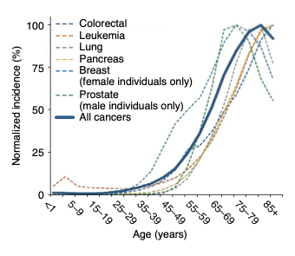
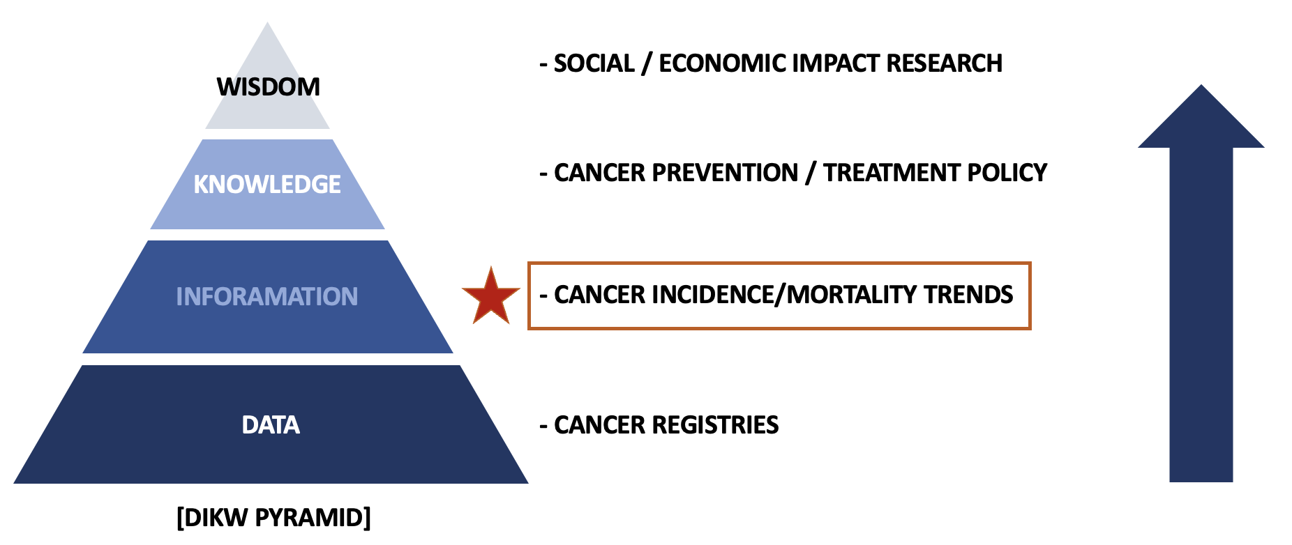
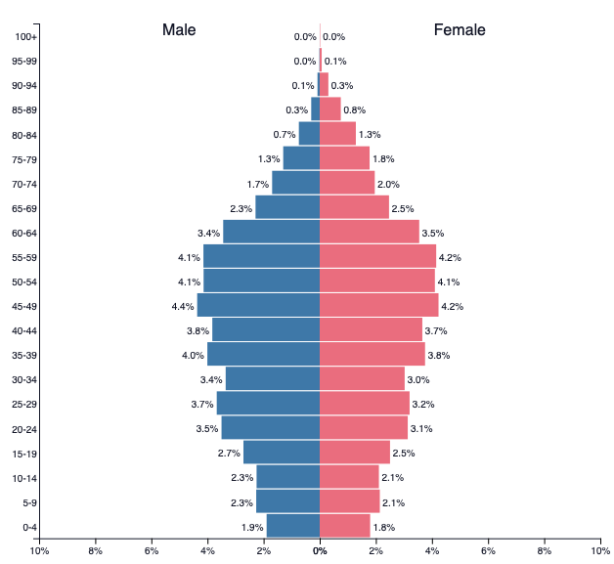
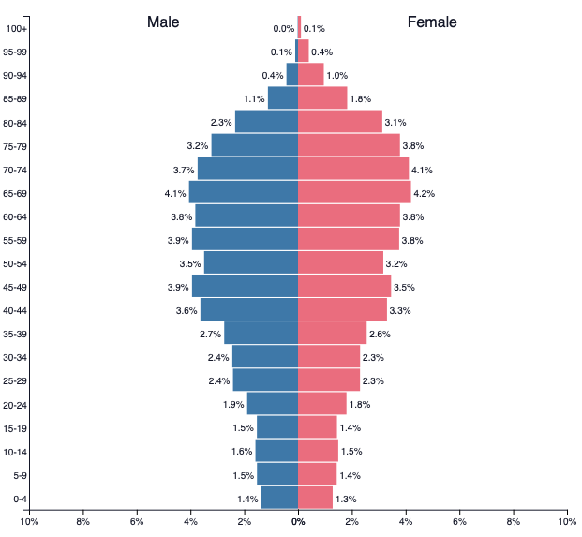
Why focus on aging in cancer burden measurement?
The importance of aging in cancer research.
Nat Aging 2, 365–366 (2022)
Changing demographics in South Korea 2019 to 2040
Introduction
Methods
Analysis & Results
Discussion
Conclusions
Notes:
Previous Studies have shown that aging is strongly associated with cancer incidence and mortality.
This has the effect of accelerating the aging society.
The higher the rate of aging, the higher the burden of cancer, and the greater the social and economic challenge
also When looking at current research using the DIKW pyramid , prioritizing trends in cancer incidence and mortality can serve as a foundation for other secondary and tertiary research.
Therefore, in order to proceed with various studies, it is necessary to first identify trends in cancer incidence and mortality as a preliminary study.

Slide 4

How to estimate in cancer burden?
The scope of previous research
Cancer future incidence and Mortality case or rate
Cancer Treatment Direct or Indirect Cost
… ETC
GLM…
GAM…
Projection estimates
Stomach
Liver
Lung
.
.
.
Time Series…
JP…
Introduction
Methods
Analysis & Results
Discussion
Conclusions
Notes:
Traditionally, there have been many different ways to quantify risk.
Researchers have prioritized which outcome variables to select and then used multiple models based on the data to try to get predictive values that are plausible for the research hypothesis.
However, among the various studies in Korea, there is a lack of research on the burden of aging by cancer type, and there is no discussion on how to quantitatively measure it.

Slide 5
Previous study limitation? & Objective
► Difficult to determine how much of a predicted incidence or mortality rate is affected by aging
► Fewer studies comparing different models for the same cancer type
► No comparisons of differences in model predictions across different demographics are presented, estimated value may be biased.
→ Use decomposition analysis to identify incidence, mortality contributions due to aging
→ Compare predictions from different models by cancer type
→ Employing scenario-specific prospective population projection data based on different demographic assumptions
Introduction
Methods
Analysis & Results
Discussion
Conclusions
Notes:
Therefore, a method to quantify the domestic cancer burden in line with aging factors is needed, and the following challenges and measures have been identified.
First, there are three main limitations of previous studies:
For each problem, we decided to do the following

Slide 6





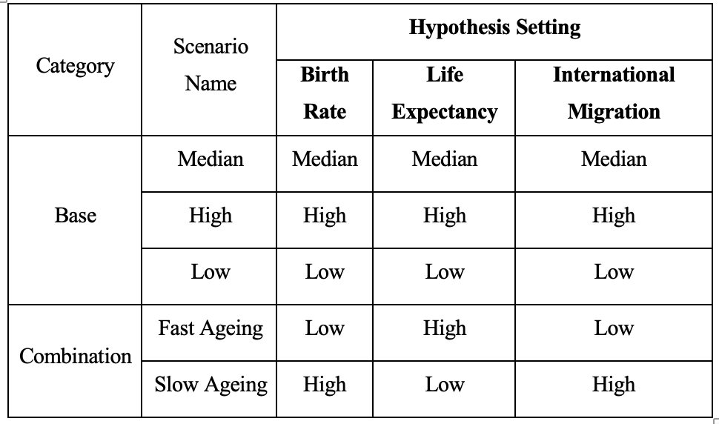

Introduction using data
~1999
2000-2019
2020 ~
Age Category not exist 85+
Cancer incidence / mortality
Bias for COVID - 19
Introduction
Methods
Analysis & Results
Discussion
Conclusions
Notes:
1) Here's the data we used in our study
1)We utilized population data cancer registrations, deaths, and from KOSIS
(Koreans ststistical informations service)
2) Data prior to 1999 was excluded due to incomplete categorizTion by age group, and data after 2020 was excluded due to concerns about underestimate bias during the COVID-19.
3) So we only used data from 2000-2019 to do our estimates.
4) Based on the scenario hypothesis set by the National Statistical Office, five scenarios were selected for projection.

Slide 7
Introduction selection ageing related cancer framework
Cancer incidence & mortality by age/ cancer types/sex in korea in 2019
Condition1 : Comparison1 and Comparison2 rate ratio ≥ 2 and comparison3 rate ratio ≥1
Inclusion criteria
Condition2 : Incidence rate in all age & in 65+ age within the highest 10 rank
- Introduction selection ageing related cancer framework
Exclusion criteria
Condition3: 00-34, 35-49,50-64 age group aapc increase & 65+ age gorup aapc decrease
Ageing related cancer selection in incidence rate
Ageing related cancer selection in mortality rate
Unifying cancer type
Final Selection
Final Selection
Ageing related cancer selection framework
Introduction
Methods
Analysis & Results
Discussion
Conclusions
Notes:
Due to the large number of cancers available, we decided to limit ourselves to cancers that are expected to be highly affected by aging.
It has been developed based on the conditions that take into account the changes in rate ratios by age group and patterns in incidence and mortality by age group in previous studies.
We selet for ageing related cancers by determining fit above conditions

Slide 8
Introduction projection methods & decomposition analysis
[ Selection Projection Method ]
[ Decomposition Analysis ]
Population Ageing
Category | Model | Name
Population Struture -based | GLM | Age-Drift-Period-Cohort (Nordpred)
 | APC | Bayesian-Age-Period-Cohort
Non-Population structure-based | GLM | JOINPOINT
 | Time Series Model | ARIMA
 |  | Space-State Model Linear
Population Growth
Rate Change
Difference number of cases and deaths
. . .
[Ref]
Time
Introduction
Methods
Analysis & Results
Discussion
Conclusions
Notes:
The models used in the study were selected as representative of many existing studies and were divided into two types to differentiate between the models.
first category is population -structure based model, second category is non population structure based model
According to this categorization, each model is either directly influenced by population data or not.
The decomposition method separates the number of incidents or deaths by attribution.
After setting a reference year (for example, incidence reference year is 2000, and mortality refernce year is 2005), the difference in incidents or deaths compared to that year can be separated into three components
This is how we can determine the contribution of aging.

Slide 9
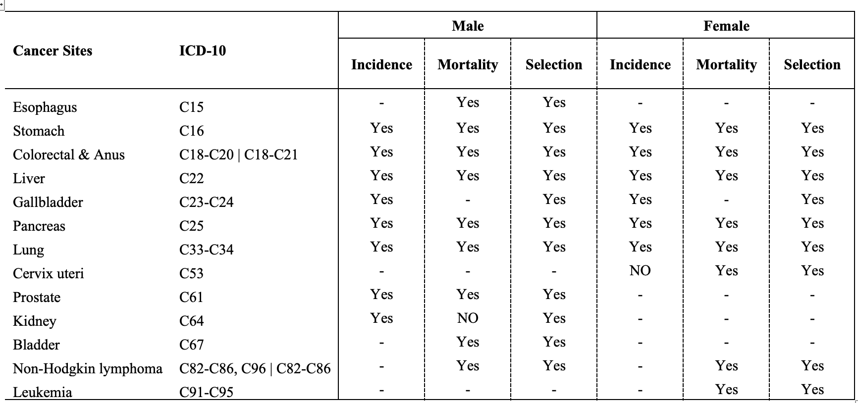
Result I: Selection ageing-related cancer
In both genders, aging is significantly correlated with the incidence and mortality of major cancers, including stomach, colorectal, liver, and lung cancer.
Gallbladder and kidney cancers are only in incidence.
Esophagus, cervix uteri, bladder cancer, non-Hodgkin's lymphoma, Leukemia only for mortality.
Introduction
Methods
Analysis & Results
Discussion
Conclusions
Notes:
We included all ageing related cancers with incidence and mortality rates selected through the previous inclusion and exclusion criteria.

Slide 10
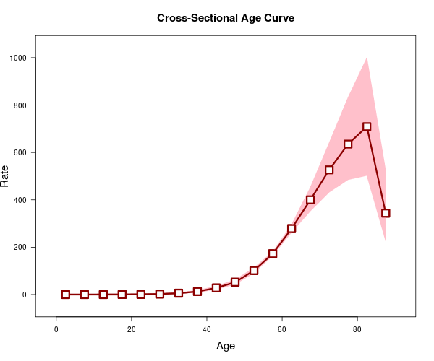
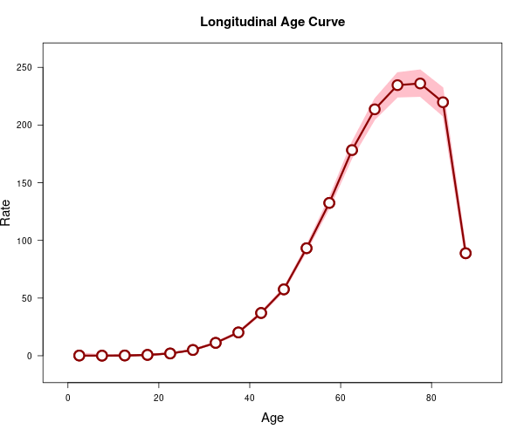
Result I: Validation ageing-related cancer
[e.g., Male Incidence in Stomach Cancer]
[Cross Sectional Age Curve]
Longitudinal Age Curve]
[ Age-Period ]
[ Age-Cohort ]
Despite gender differences, the incidence and mortality rates for most cancers tend to increase with age.
Introduction
Methods
Analysis & Results
Discussion
Conclusions
Notes:
We used Age period cohort to test the validity of the selected cancer types.
This analysis compares two aspects
The first is the difference in incidence and mortality over time, called the cross-sectional age curve.
The second is the difference in incidence and mortality rates for an age-cohort, called a longitudinal age curve.
This analysis underscores the higher incidence and mortality rates in older demographics for most cancers.
As an figure, male stomach cancer exhibits an increasing incidence rate over the observation period, with older cohorts within the same period also demonstrating a gradual increase in incidence over time.

Slide 11
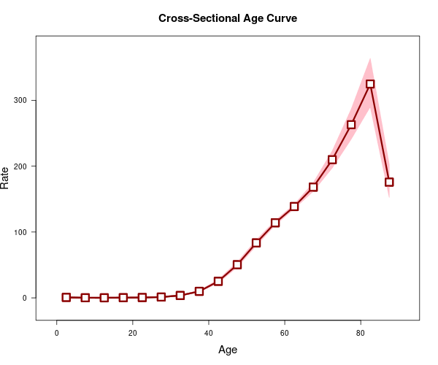
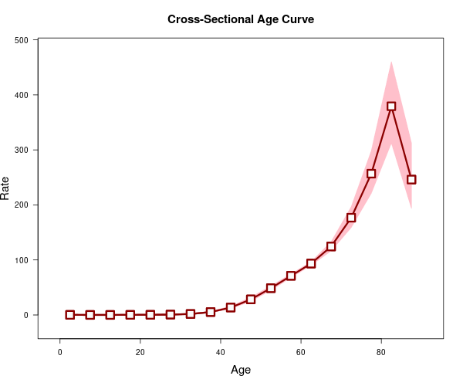
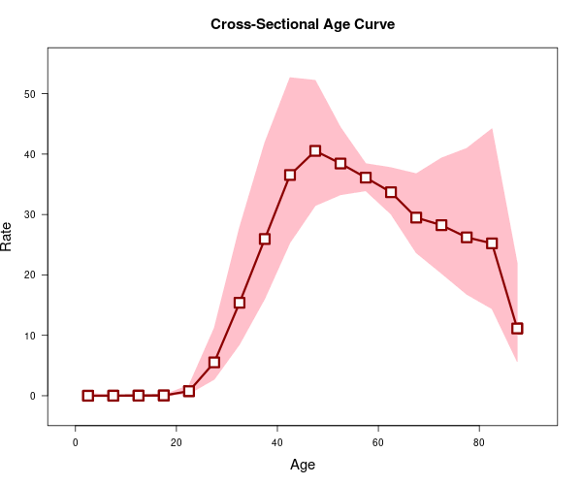
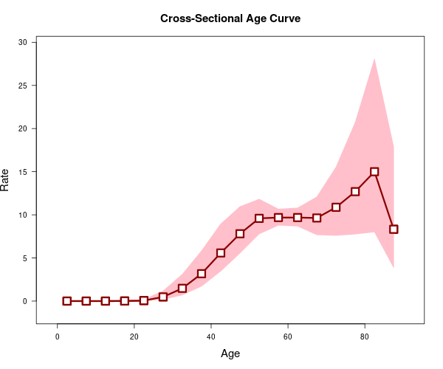
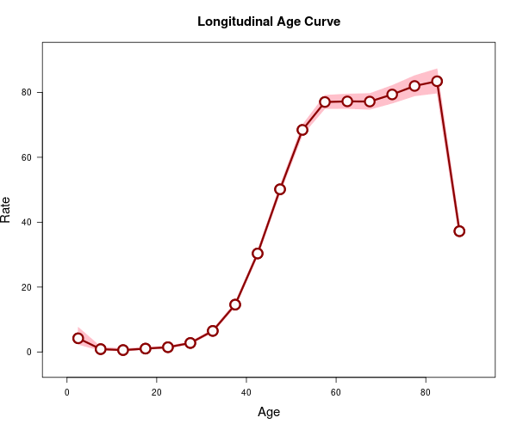
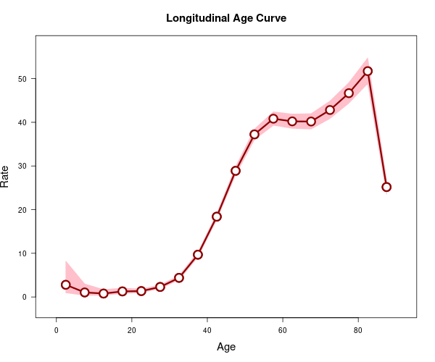
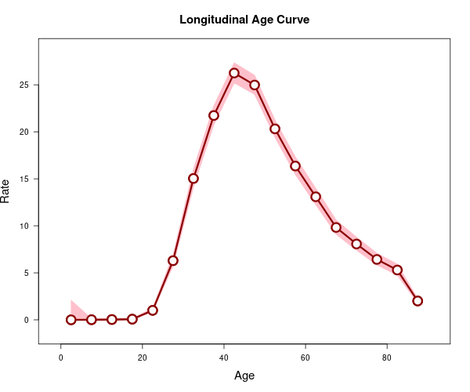
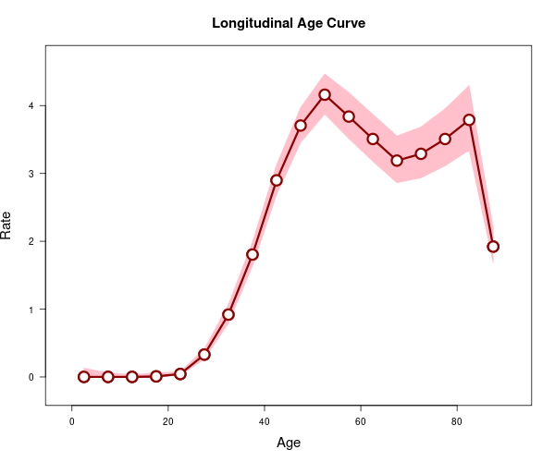
Result I: Validation ageing-related cancer
[ Male Liver Cancer ]
[ Female Cervix Uteri Cancer ]
[ Age-Period ]
[ Age-Period ]
[ Age-Cohort ]
[ Age-Cohort ]
Incidence
Mortality
Incidence
Mortality
Higher incidence and deaths in the 40+ cohort and as age increases
High incidence rate in middle-aged people, older groups also show a high rate in mortality.
Introduction
Methods
Analysis & Results
Discussion
Conclusions
Notes:
However, different trends were observed in cancers like liver cancer in men and cervical cancer in women.
Each cancer type has different characteristics.
In terms of male liver cancer, while the age-period trend is akin to previously mentioned cancers, the cohort perspective shows a substantial increase in middle-aged cohorts.
This suggests a consistently higher incidence and mortality for liver cancer at younger ages compared to other cancers.
Contrarily, women present different trends across both age-periods and cohorts.
Incidence tends to peak in middle age, while mortality increases in older age groups in the age-period view, but not significantly compared to middle age.
From a cohort perspective, similar to liver cancer, a gradual increase in mortality is observed from middle age onwards, despite already high mortality in older cohorts.

Slide 12


Result II: Compare projections from different models by sex, cancer type
Is the pattern of increase or decrease the same across models?
Do suggest similar predictions by models
Incidence | Mortality
Gallbladder Pancreas Lung Prostate Kidney Baldder | Gallbladder Stomach Colorcetcal & Anus Pancreas Lung Prostate Kidney Baldder Non-Hodgkin
Incidence | Mortality
Gallbladder Pancreas Cevix ulteri Lung Non-Hodgkin | Stomach Gallbladder Pancreas Non-Hodgkin
Similar Trend
Similar Trend
Incidence | Mortality
Esophasgus Stomach Colorectal Liver Non-Hodgkin | Esophasgus Liver
Incidence | Mortality
Stomach Colorectal Lekemia Liver | Colorectal & Anus Liver Lung Cevix ulteri Lekemia
Different Trend
Different Trend
Introduction
Methods
Analysis & Results
Discussion
Conclusions
Notes:
We wanted to see the difference in projection estimates based on the selected cancers.
We wanted to compare the two in the following ways
Is the pattern of increase or decrease the same across models?
Do suggest similar predictions by models
The following results compare the trend patterns of the model by cancer type for men and women.
Here, similar trend means that there is a common increasing or decreasing trend despite differences in the predicted estimates of the models.
DIFFERENT TREND means that not only do the models have different predictions, but the trend of each fitted model is a mix of increasing and decreasing.
Some cancers showed a similar pattern of projection estimates across models, while others showed different patterns
Liver cancer, in particular, showed different patterns of both incidence and mortality in men and women.

Slide 13
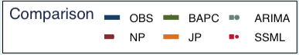
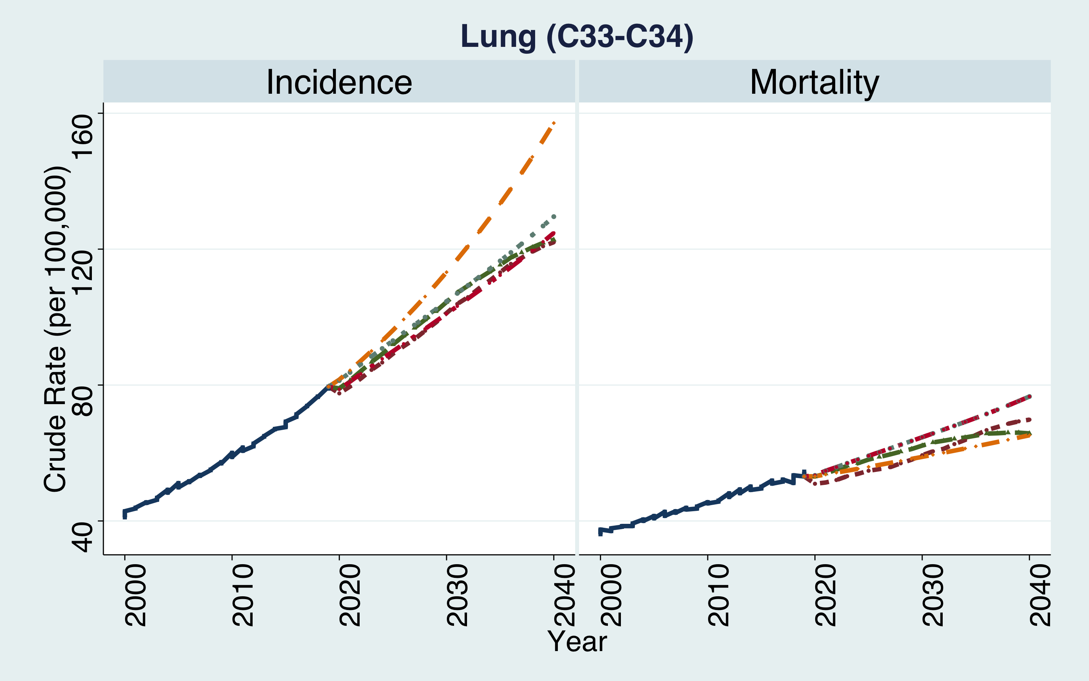
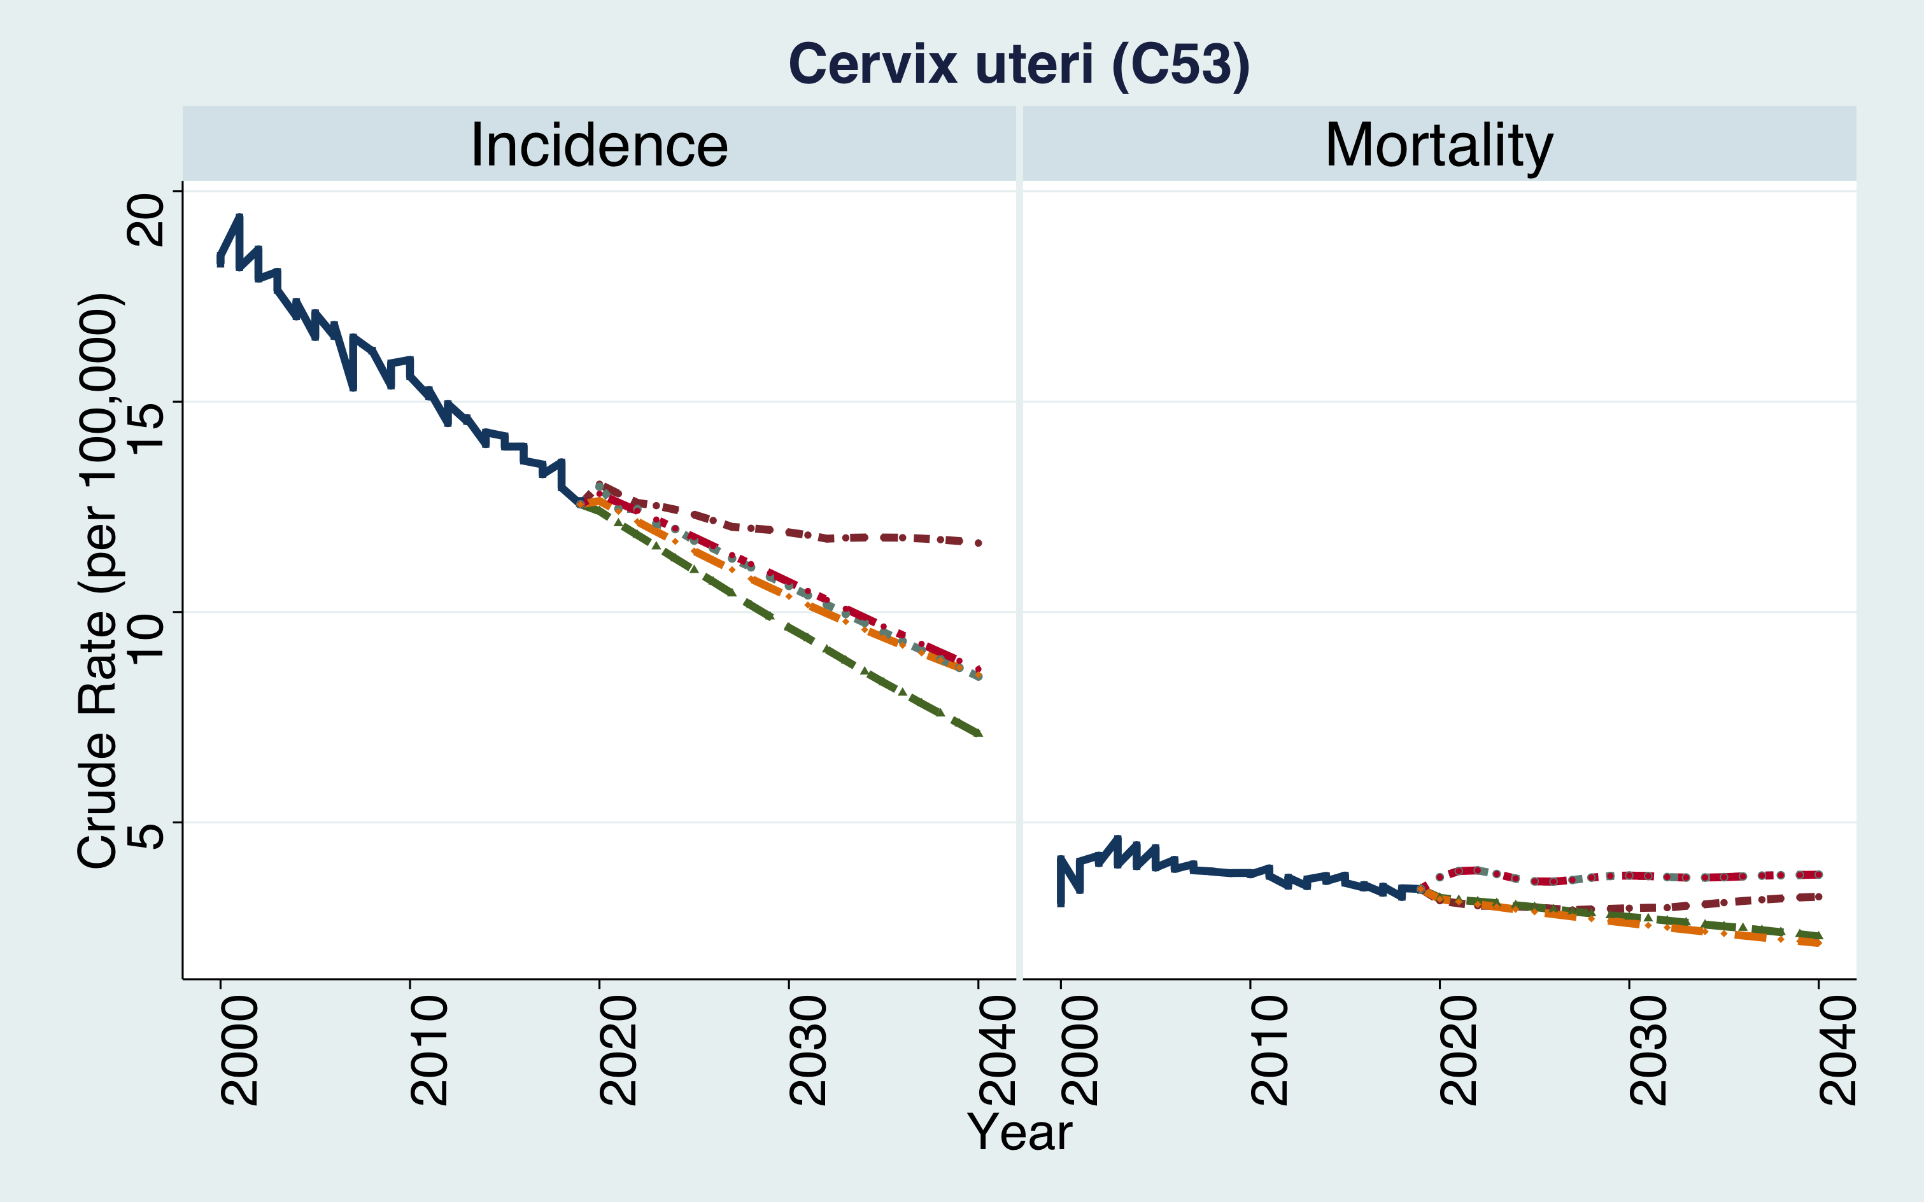
Result II: Compare projections from different models by sex, cancer type
e.g., Male Lung Cancer
e.g., Female Cervix Uteri Cancer
Increasing Trend
Decreasing Trend
Introduction
Methods
Analysis & Results
Discussion
Conclusions
Notes:
We'll show examples of each type of trend.
These figures are examples of similar trends.
There is some variation in the predicted values between models, but all models are showing the same increase or decrease.

Slide 14
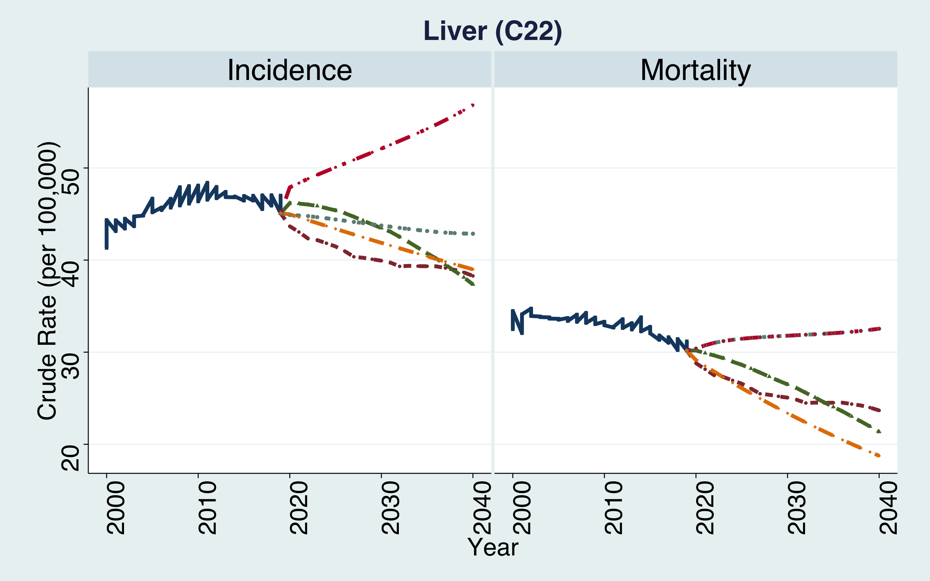
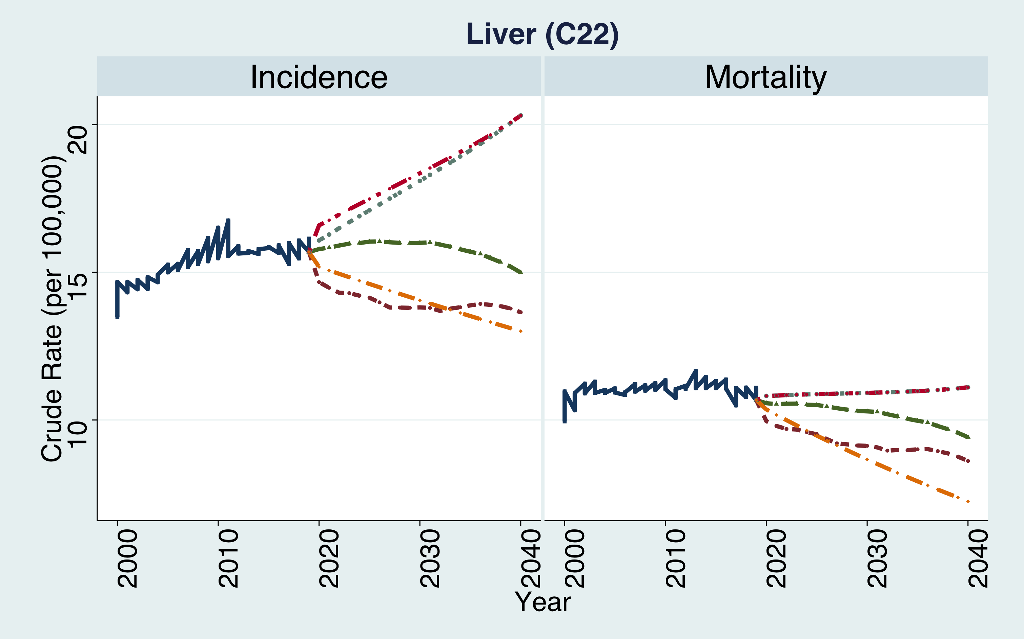
Result II: Compare projections from different models by sex, cancer type
e.g., Male Liver Cancer
e.g., Female Liver Cancer
Increasing | Constant | Decreasing Trend
Increasing | Constant | Decreasing Trend
Introduction
Methods
Analysis & Results
Discussion
Conclusions
Notes:
These figures are examples of different trends.
These figures use liver cancer as an example for both men and women.
They show different forms of incidence and mortality forecasts, with three different forms of predicted values: increasing, constant, and decreasing.

Slide 15
Result II: Compare projections from different models by sex, cancer type
Category | Name | Features for model fitting
Population Struture-based | Nordpred | somewhat compensates for irregular patterns Consistency in trend forecasting
 | BAPC | Excellent prediction of rare cancers with relatively few cases Ease of over-estimation in long-term forecasting Sensitive to predictions when patterns are irregular
Non-Population structure-based | JOINPOINT | Forecasts based on the last joinpoint can lead to significant overestimation in long-term predictions, especially when the period slope value is large. Sensitive to predictions when patterns are irregular
 | ARIMA | Fixed future predictions when noise decomposition reaches a limit Sensitive to predictions when patterns are irregular (If the pattern is constant, it has NP-like predictions)
 | SSML | Fixed future predictions when noise decomposition reaches a limit Sensitive to predictions when patterns are irregular
→ Nordpred (NP) models are suitable for Projection
Introduction
Methods
Analysis & Results
Discussion
Conclusions
Notes:
The table shows the characteristics of each model and describes the differences when generating predictions.
Here are some general characteristics of the predictions for each model
NP models are commonly used to predict long-term trends. They are proven in terms of validity and have good predictive power even with irregular time series data.
However, since the validation was limited to overseas data, it is not known whether it is highly predictive for all cancers in domestic data.
Other models have a common disadvantage of being sensitive to irregular patterns, which is why they don't show consistent trend predictions across cancers and may even show errors such as overestimation.
Validation of future data is difficult, which is why we can use model-specific statistics such as AIC and BIC, or 95% CI to determine the reliability of our predictions, but we were unable to find a common statistic across models to derive each model-specific statistic.
For this reason , the use of a universal model like nordpred may be recommended

Slide 16
Result II: Compare projections from different models by sex, cancer type
FINDINGS!
Some cancers showed different trends by sex and model depending on the type of cancer.
There were cancers with significantly different model predictions for the same cancer type (when trending the similar).
To reflect the focus of a follow-up study (e.g., socioeconomic, policy) using cancer incidence/mortality projection, the need for the user to select the appropriate model is required.
Predicting long-term trends requires the use of NP models that are insensitive to irregular patterns and do not induce sharp biases for all cancers.
Introduction
Methods
Analysis & Results
Discussion
Conclusions
Notes:
In the preceding results, we found that
1) Some cancers showed different trends by sex and model depending on the type of cancer
2) There were cancers with significantly different model predictions for the same cancer type
These results suggest that it is important for researchers to select appropriate models based on sex, cancer type, and what they want to emphasize in subsequent studies.
It also seems reasonable to use the commonly used NP model when comparable statistics across models are absent or limited.

Slide 17
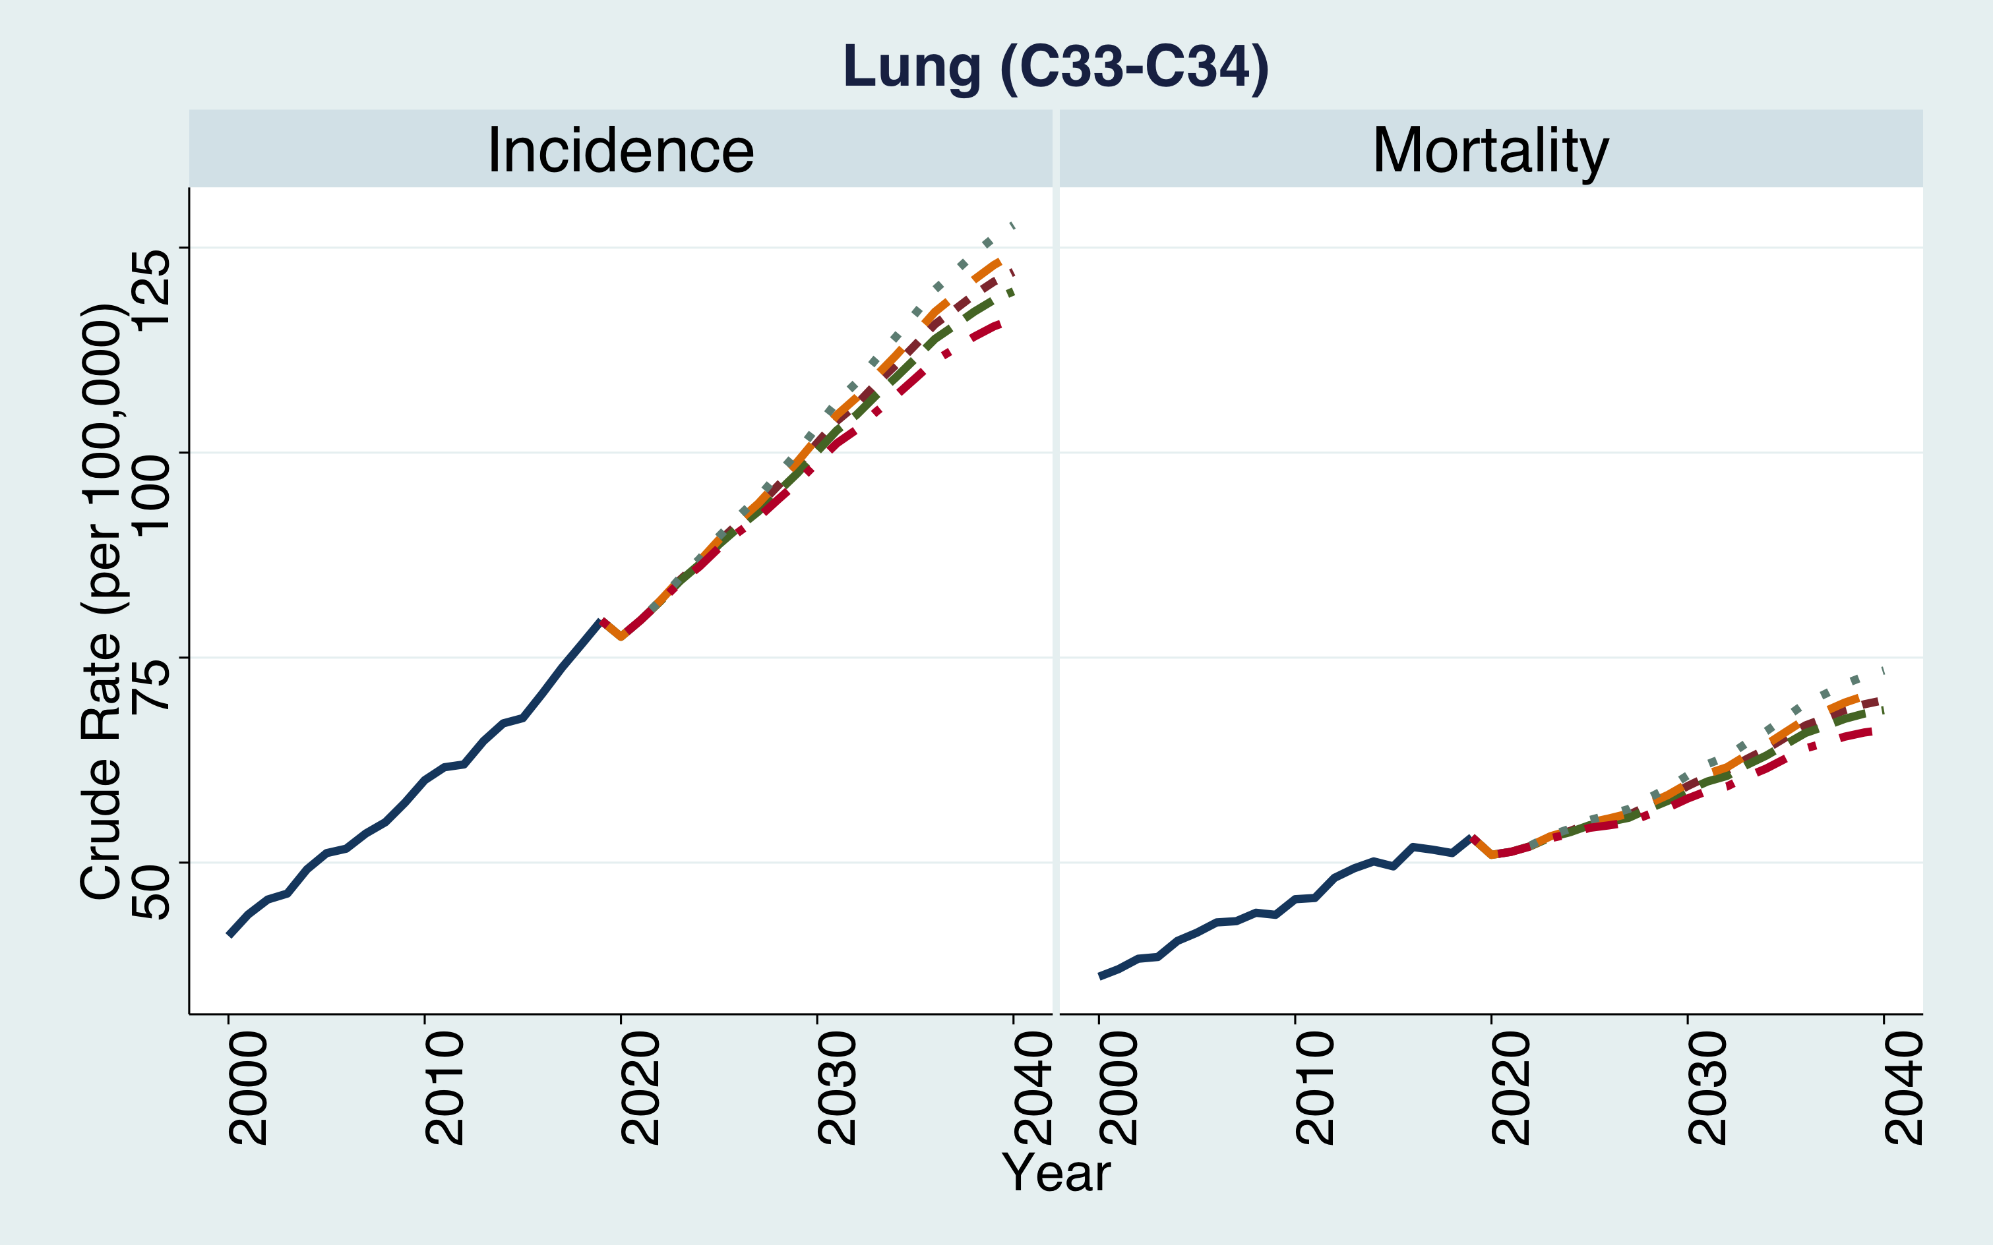
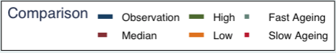
Result III: Compare projections from different scenarios by sex, cancer type
Fast Ageing > Low > Median > High > Slow Ageing
Incidence | Median | High | Low | Fast Ageing | Slow Ageing
2019 | 79.5 | 79.5 | 79.5 | 79.5 | 79.5
2030 | 101.2 | 100.2 | 101.8 | 103.2 | 98.8
2040 | 122.0 | 119.7 | 124.3 | 127.8 | 116.3
Mortality
2019 | 53.1 | 53.1 | 53.1 | 53.1 | 53.1
2030 | 59.3 | 58.8 | 59.6 | 60.6 | 57.8
2040 | 69.8 | 68.6 | 70.9 | 73.4 | 66.2
[ e.g., Male Incidence]
The effects of population growth resulting from rising birth rates less those of population stagnation due to declining birth rates and aging population growth resulting from declining birth rates.
In fast aging societies, there is increase of within 5% in incidence and mortality rates than median estimates
Introduction
Methods
Analysis & Results
Discussion
Conclusions
Notes:
The following results show the projections for each scenario.
The model used is the NORDPRED model, which was chosen because it was the most robustness among the models based on previous estimates results.
We’ll use lung cancer as a representative example because most cancers show similar differences between scenarios
The ranking of the projections estimates per scenario is as follows:
These results can have the following interpretations
The effects of population growth resulting from rising birth rates less those of population stagnation due to declining birth rates and aging population growth resulting from declining birth rates.
In fast aging societies, there is average median increase of within 5% in incidence and mortality rates.

Slide 18
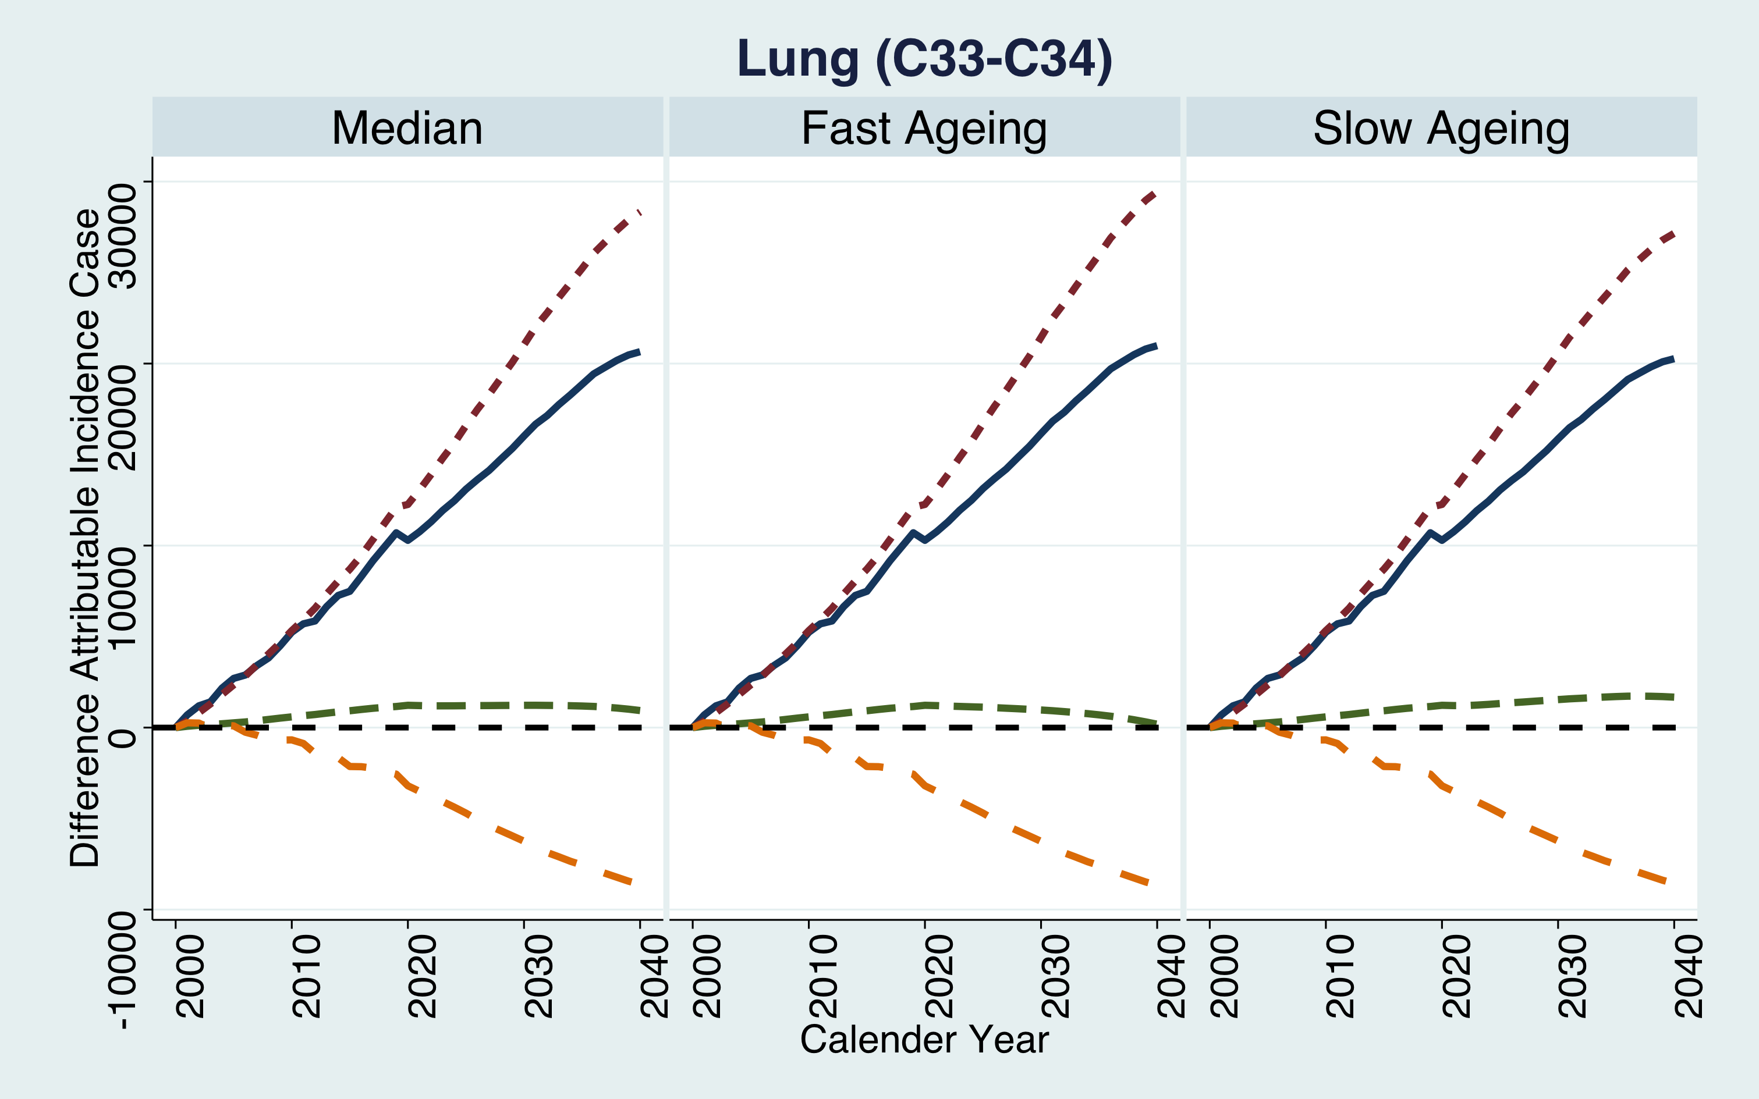
Result III: Compare decomposition projection by sex, cancer type
1) The impact of population growth factors on cancer incidence and mortality varies depending on the scenario, however, their contribution remains negligible.
2) Aging factors are a major contributor to the increase in cancer cases or deaths, and the magnitude of this contribution is significant.
3) The proportionate increase in ageing factors is proportional to the increase in the projection model.
[ e.g., Male Incidence Lung Cancer ]
Introduction
Methods
Analysis & Results
Discussion
Conclusions
Notes:
The final result is a decomposition analysis based on the predicted results for each scenario.
While there are differences in the results for factorization by cancer type, we choose one representative cancer type to illustrate because the contribution of the effect of aging factors is dominant in most cancer types.
Here, we could see that
The effect of aging factors contributes more than the difference in actual incidence or deaths, but population growth or a gradual decrease in actual occurrences or deaths suppresses this effect, resulting in a suppressed number of incidence or deaths.
We can also see that as we enter an aging society, the contributing effect of population growth decreases and the effect of the aging factor increases.

Slide 19
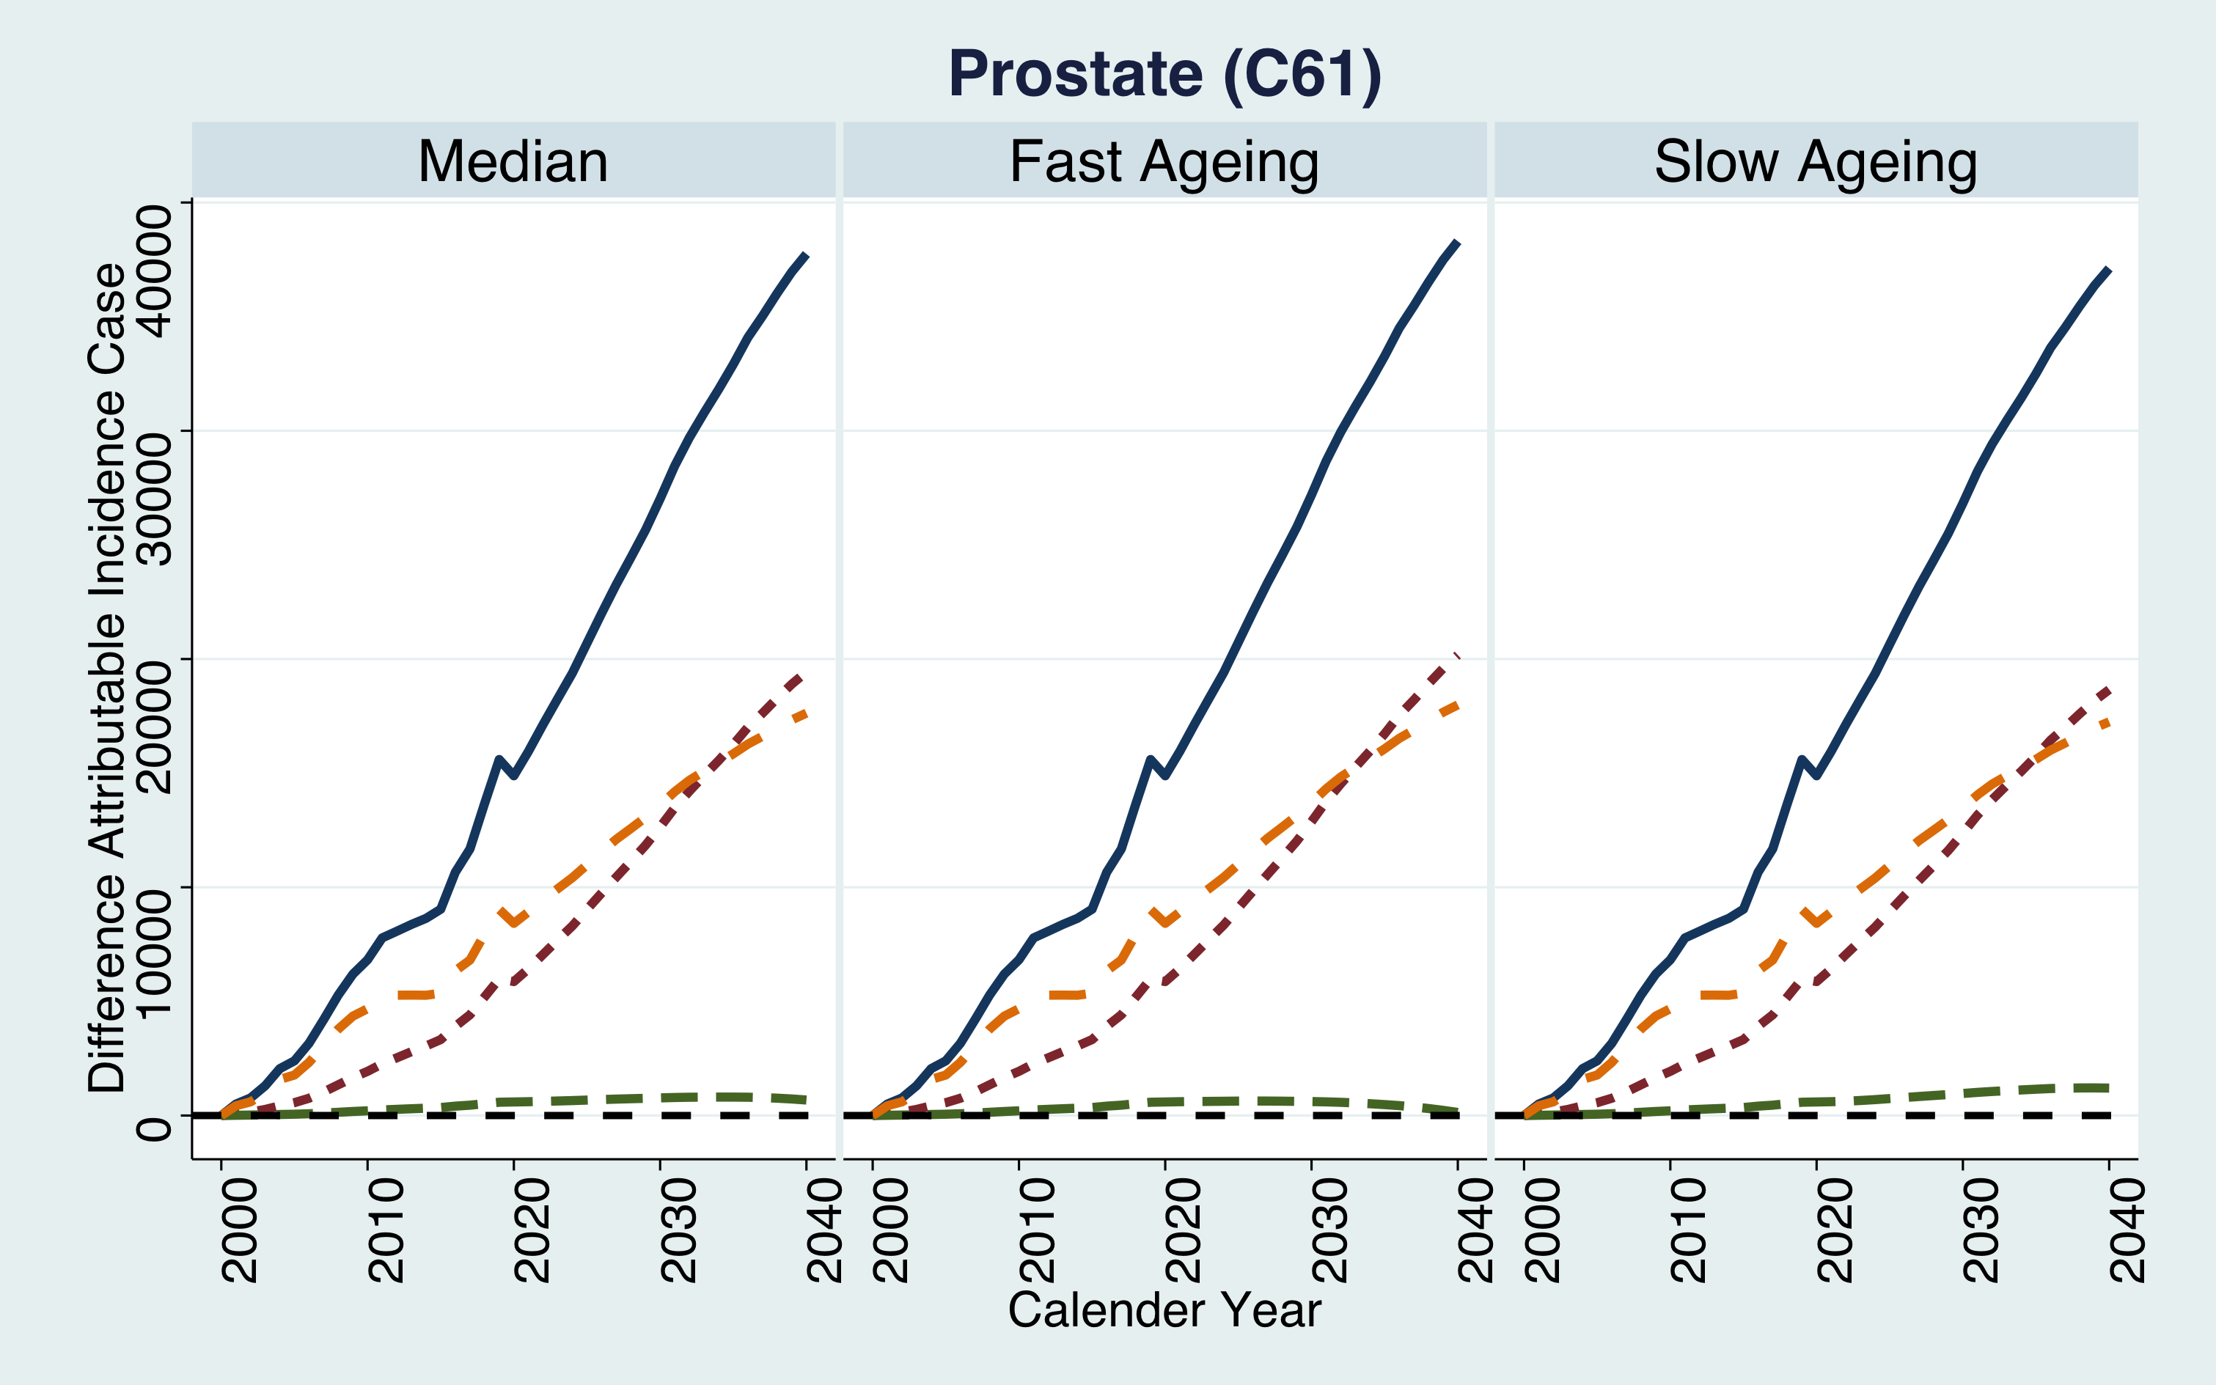
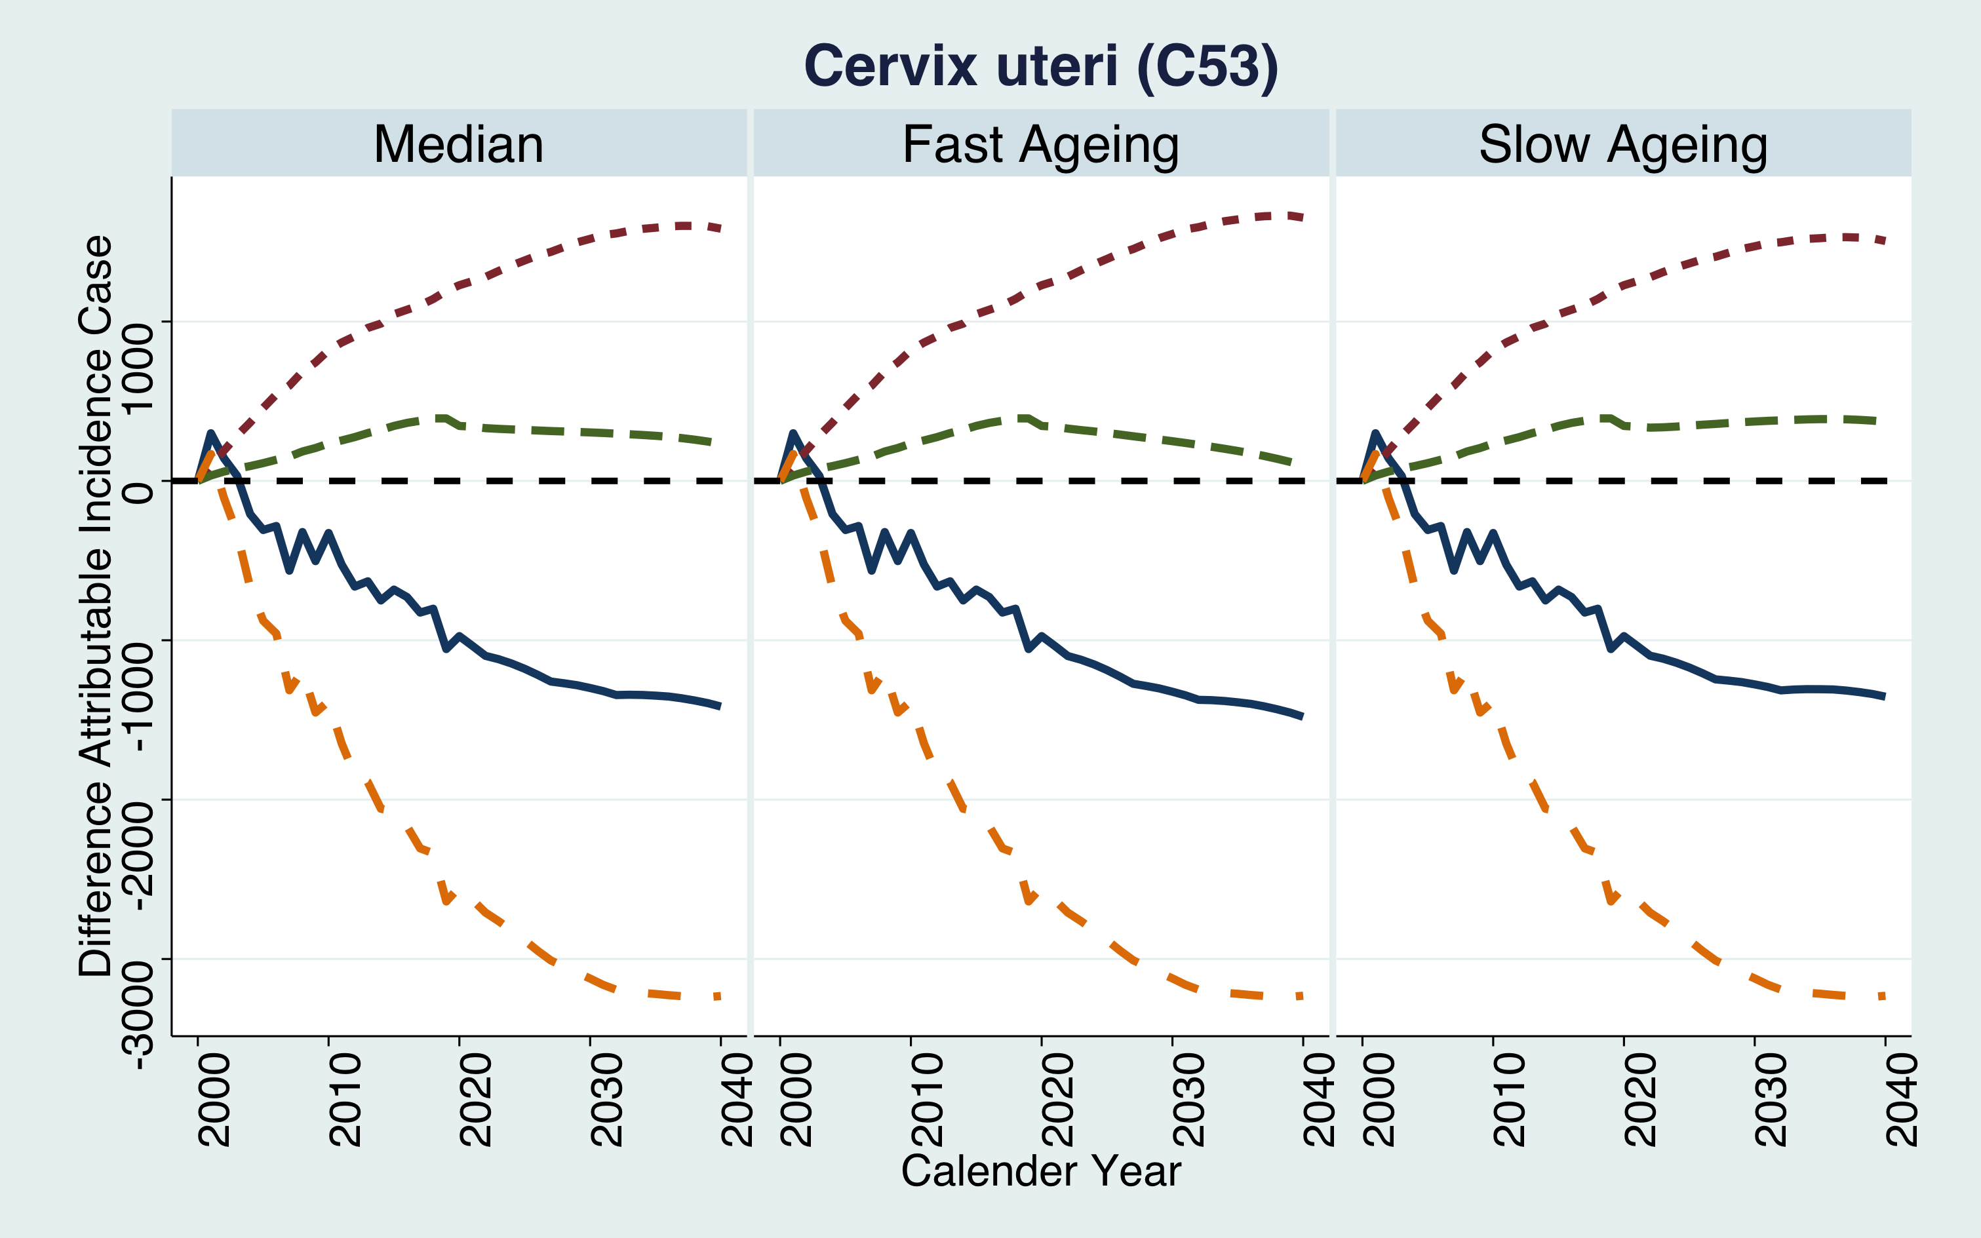
Result III: Compare decomposition projection by sex, cancer type
[ e.g., Male Incidence]
[ e.g., Female Incidence]
Indicating that reducing the contribution of aging factors through appropriate policies can have a significant impact on reducing incidence.
Introduction
Methods
Analysis & Results
Discussion
Conclusions
Notes:
Of course, there are other cancers that tend to behave differently from the above.
Examples include prostate and cervical cancer.
In prostate cancer, the risk attributable to aging and the disease itself increases simultaneously, with the aging effect becoming predominant at later stages, which is observed as an elevated risk and incidence in older cohorts.
Conversely, cervical cancer incidence tends to decrease, likely because the decline in disease risk outpaces the aging effect. After 2030, the aging influence appears to decrease, suggesting its diminished relevance in long-term trends.
Nevertheless, the effects of aging persist in both cancers, indicating that reducing the contribution of aging factors through appropriate policies can have a significant impact on reducing incidence.

Slide 20
Discussion
SUMMARY
LIMITATION
1) The high contribution of ageing to cancer incidence and mortality
2) Developing into a fast aging society may contribute to the high cancer burden and the continuation of the current lower birth rate is problematic.
3) The need for appropriate model selection for different predictive values of different models (NP model is better when it's difficult to compare statistics across models)
Short-term observations may reduce the predictive power of models.
The cancer registry during COVID-19 may lead to underestimates in future model fits for cancer incidence and mortality. However, since this is real recorded data, it is necessary to develop a suitable model to correct for this effect. (Because we can't afford not to use data from that period.)
Introduction
Methods
Analysis & Results
Discussion
Conclusions
Notes:
I will discuss the significance findings and limitations of our study.
in this perspective of findings,
And in this perspective of limitation,

Slide 21
Conclusion & Contribution
We found that the extent and contribution of aging to incidence/mortality is important.
We examine the extent of the disparity by analysing the varying estimates generated by the models.
We adjusted for future uncertainty based on scenario-based data.
The study contributes by identifying the impact of aging on cancer incidence and mortality, which can guide policymakers and healthcare professionals in program or policy to mitigate its effects.
1) Additional analysis and comparison based on new data
2) Model study and development for measuring the effect of ageing factors in the cancer prevalence model
FUTURE STUDY
Introduction
Methods
Analysis & Results
Discussion
Conclusions
Notes:
Finally, the conclusions and expected contributions are as follows.
Future studies through this study are as follows.

Slide 22
Thank you
Q & A
Notes:
Thank you for listening to the presentation.
If you have any questions about this presentation, please let us know.

